Slide 1
EXPLORING TENSORFLOW

Slide 2

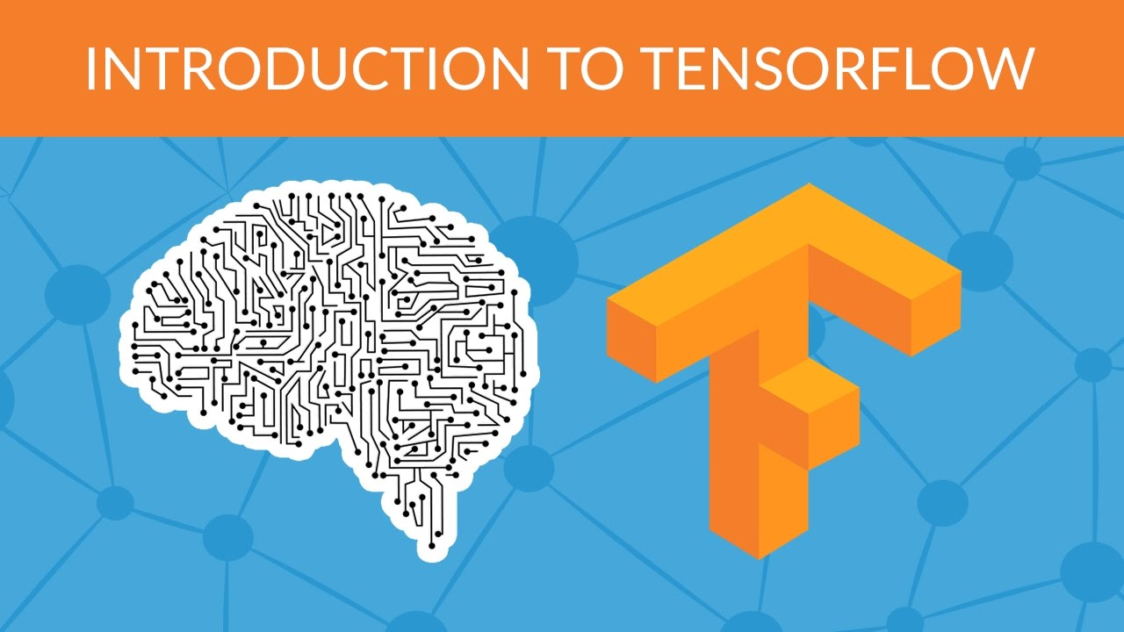
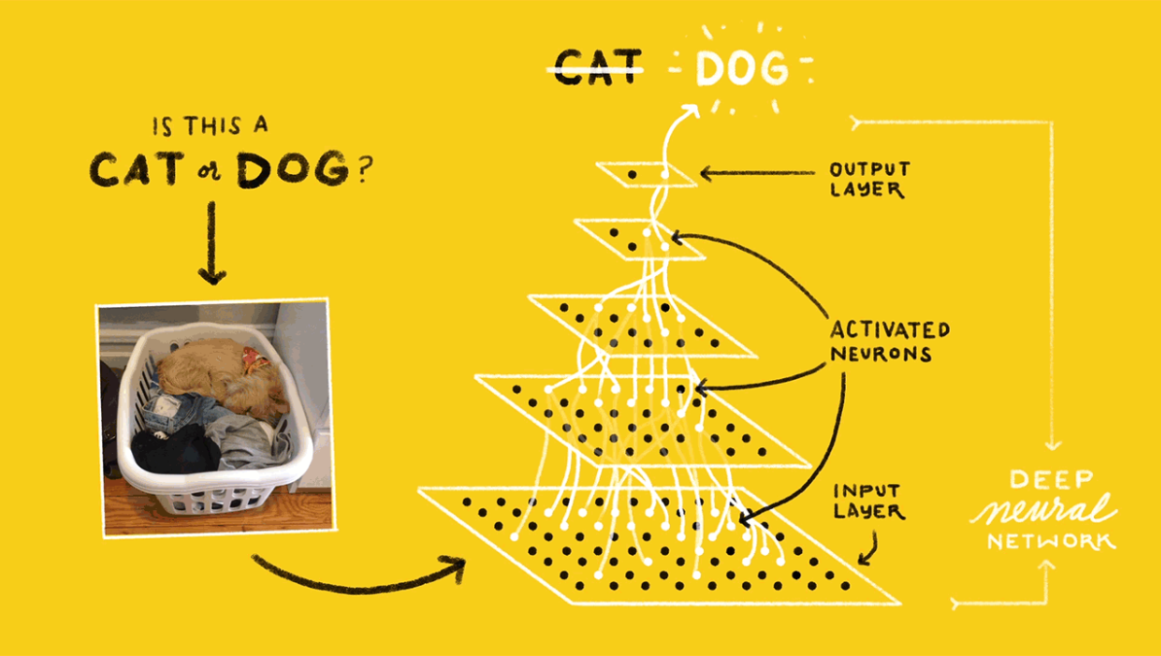
WHAT IS TENSORFLOW ?

Slide 3

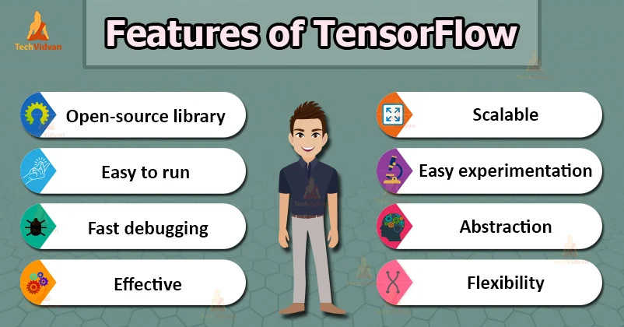

FEATURES AND USES OF TENSORFLOW

Slide 4
DEPENDENCIES REQUIRED
TO UTILISE THE FEATURES OF TENSORFLOW IN PYTHON FULLY WE USE A FEW LIBRARIES
FOR VARIOUS PURPOSES.
SOME LIBRARIES THAT ARE ESSENTIAL AND POPULAR ARE :
PANDAS KERAS SEABORN NUMPY SCIKIT - LEARN
PYTORCH

Slide 5
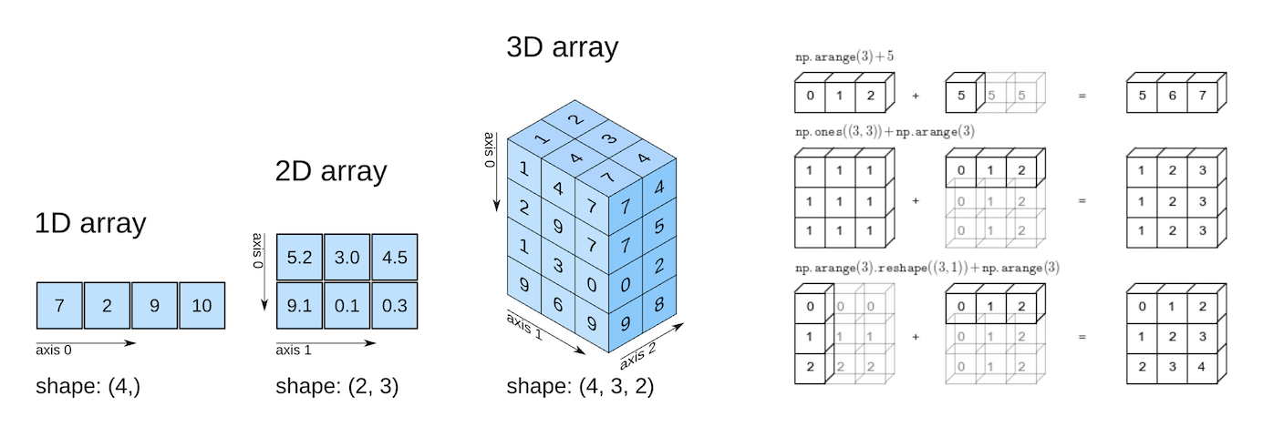

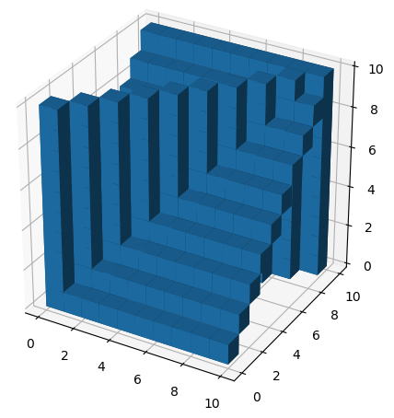
NUMPY

Slide 6


PANDAS
.

Slide 7
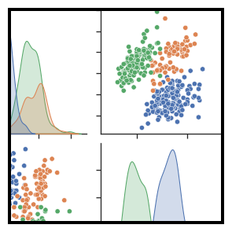


SEABORN

Slide 8

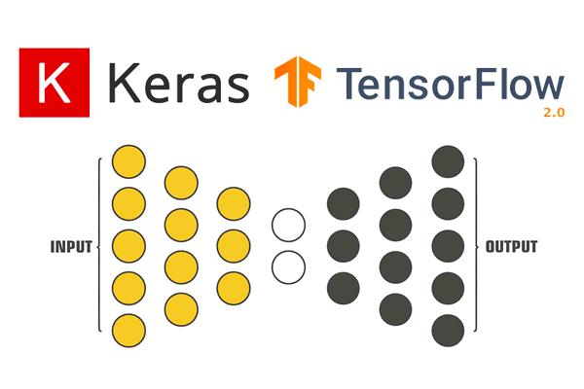
KERAS

Slide 9
BUILDING OUR OWN MODEL USING TENSORFLOW
There are five main processes when we handle machine learning models.
They are:
1.Importing Dependencies
2.Loading the training and test datasets
3.Normalising the data.
4.Compiling and building the model
5.Training the model

Slide 10
Demo
urlshortener.bitspace.org.in/fHptD
urlshortener.bitspace.org.in/rZNqq

Slide 11
TENSORFLOW WITH GPU
If a TensorFlow operation has both CPU and GPU implementations, by default, the GPU device is prioritized when the operation is assigned. For example, if a file tf.add has both CPU and GPU kernels and on a system with devices CPU:0 and GPU:0, the GPU:0 device is selected to run tf.matmul unless you explicitly request to run it on another device.
If a TensorFlow operation has no corresponding GPU implementation, then the operation falls back to the CPU device. For example, if a file tf.add only has a CPU kernel, on a system with devices CPU:0 and GPU:0, the CPU:0 device is selected to run tf.cast, even if requested to run on the GPU:0 device.

Slide 12
THANK YOU !

